Slide 1
Assignment
Half Adder and Half Subtractor using Mode Control ‘M’
Designing above ckt using least number of NAND gates only
Designing above ckt using least number of NOR gates only

Slide 2
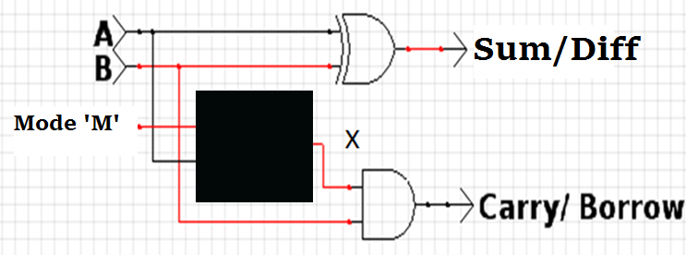
M | A | X | Comments
0 | 0 | 0 | A - Half Adder
0 | 1 | 1 | A - Half Adder
1 | 0 | 1 | A’ - Half Subtractor
1 | 1 | 0 | A’ - Half Subtractor

Slide 3
